Slide 1
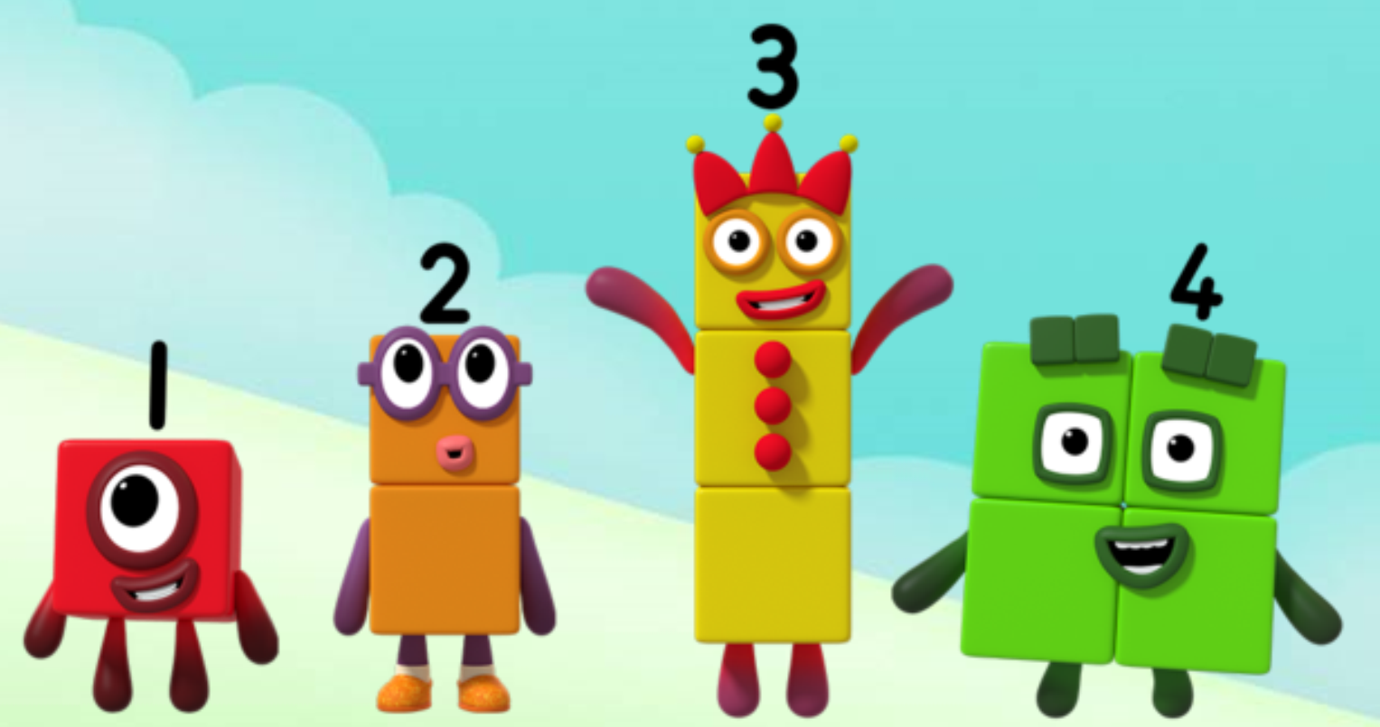
Series 1 Episode 8
Three Little Pigs

Slide 2
Maths in the Episode
To watch this episode, go to BBC iPlayer – Numberblocks. Look for Series 1: Three Little Pigs.
Counting up to 4
In this episode children can practise counting to four and spotting things which there are two, three or four of, e.g. two windows, three trees, four corners on a square. They will know that the last number in the count tells us the number of items.
Taking numbers apart and putting them back together
Children can see how each number can be taken apart and made into ‘ones’ blocks and then put back together again, e.g. Four can be taken apart and made of four ‘ones’ and the ‘ones’ can be put back together to make Four again.

Slide 3
Talk and discuss together
Watch the episode together.
Ask your child what they noticed and be interested in anything they have to say.
Use the following pictures and activities to explore and talk about the maths involved.

Slide 4
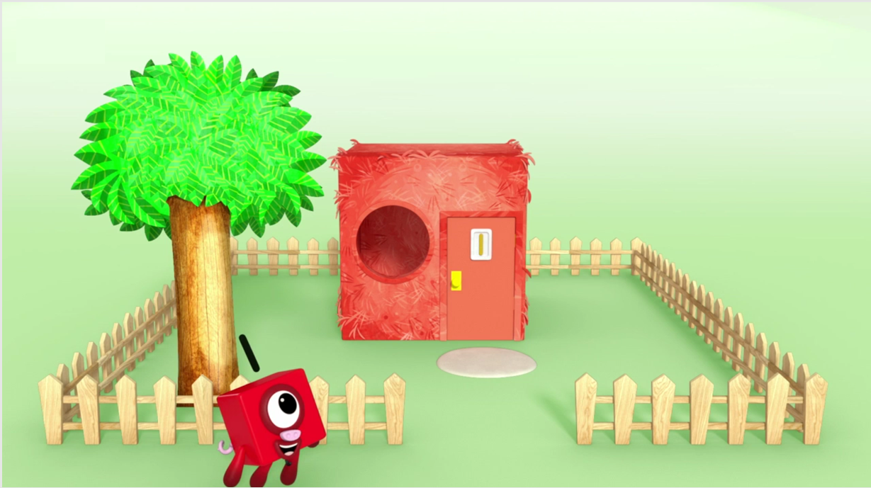
What can you see in the picture that there is one of?
Images © 2017 Alphablocks Ltd. All Rights Reserved.

Slide 5
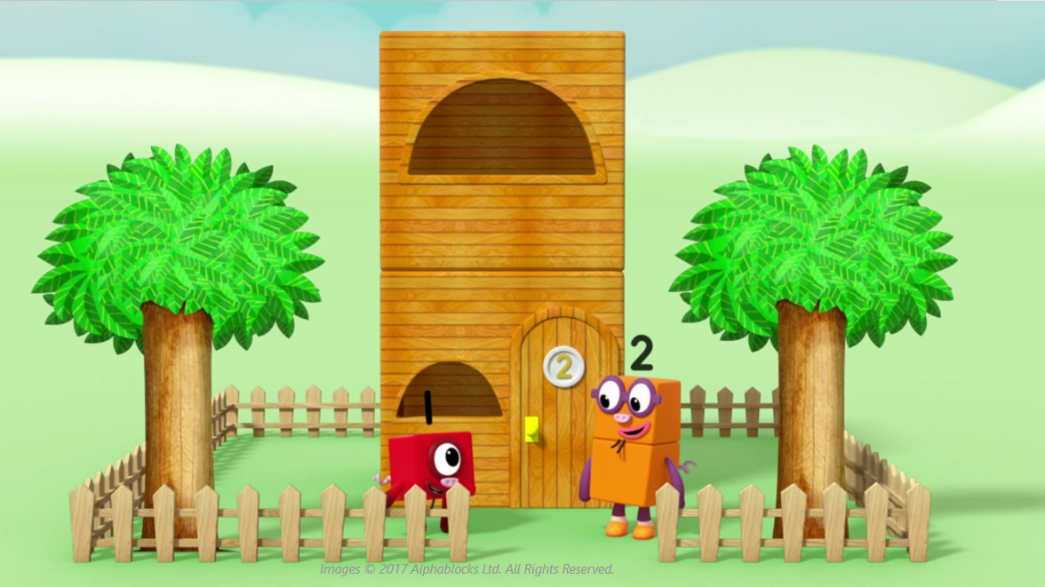
What can you see in the picture that there are two of?

Slide 6
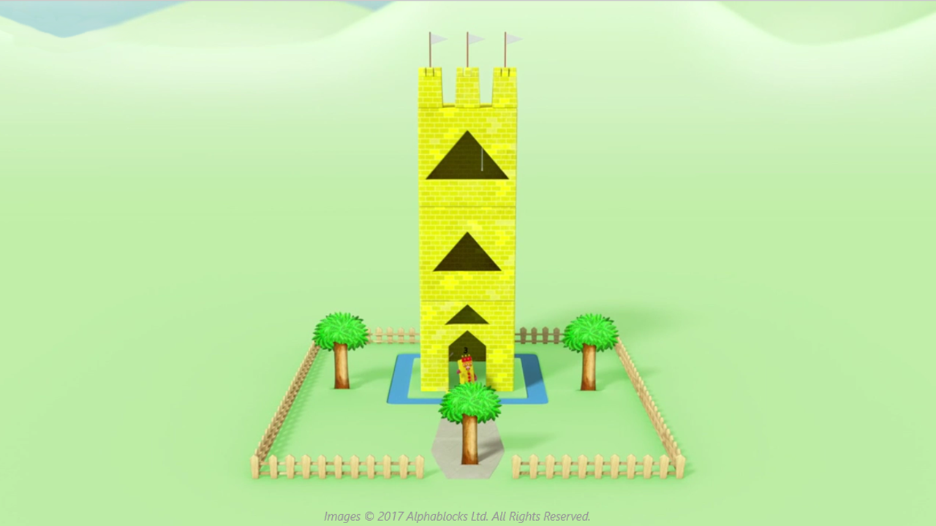
What can you see in the picture that there are three of?

Slide 7
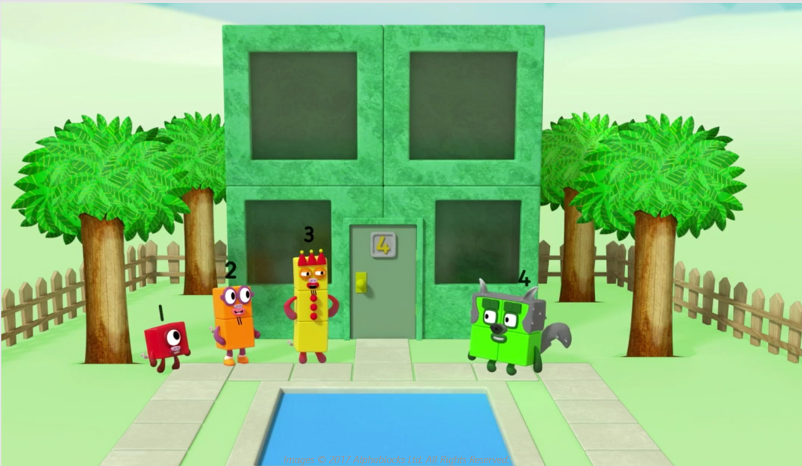
What can you see in the picture that there are four of?
Images © 2017 Alphablocks Ltd. All Rights Reserved.

Slide 8
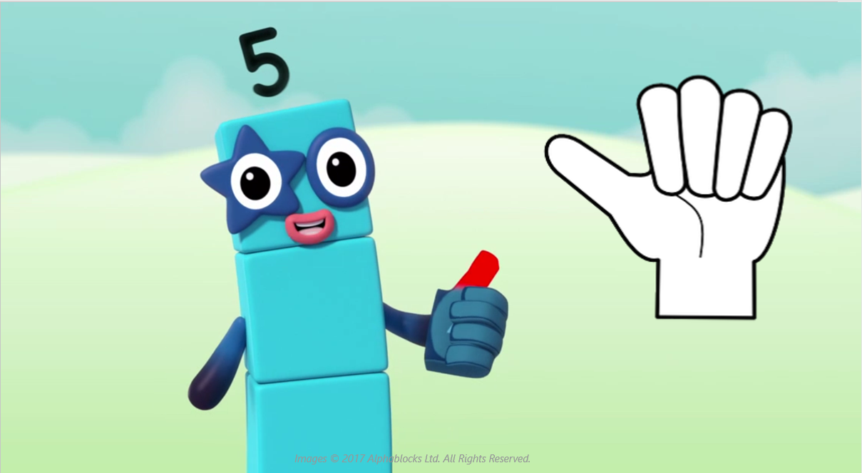
Copy me!
Show me one!
Can you show me one using a different finger?

Slide 9
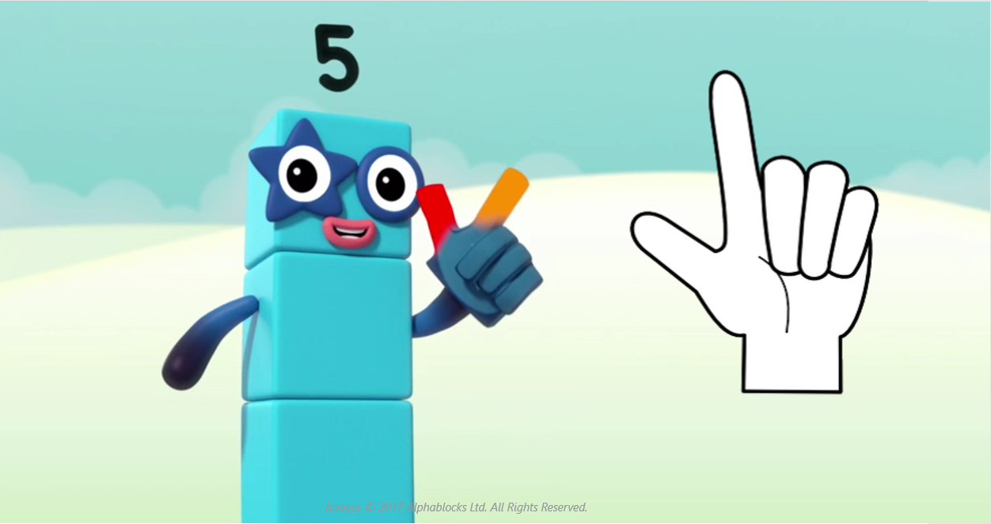
Now show me two!
Can you show me two using fingers from each hand?

Slide 10
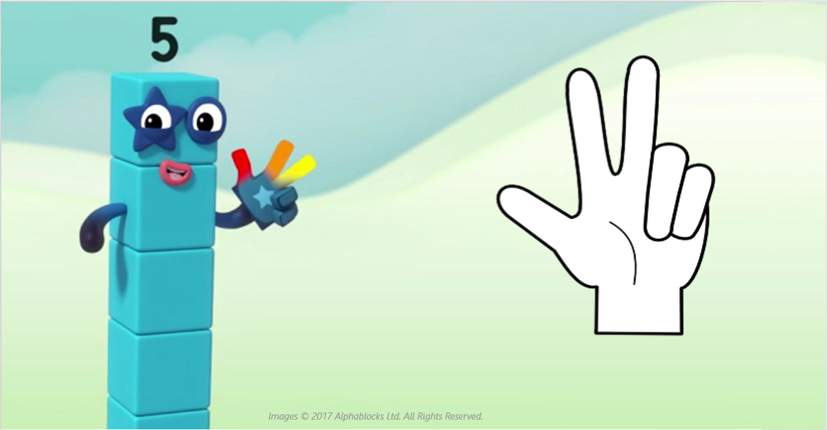
Now show me three!
Can you show me three in a different way?

Slide 11
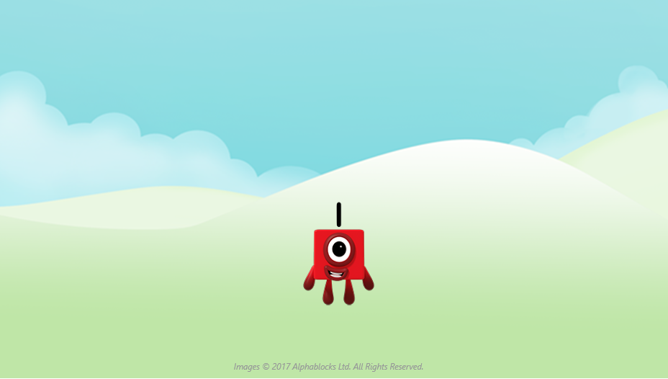
Look at each Numberblock! Use your fingers to show our numbers!

Slide 12
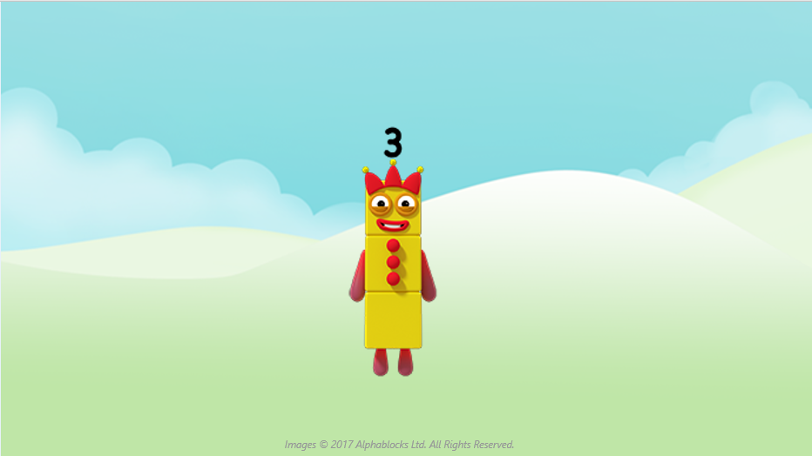

Slide 14
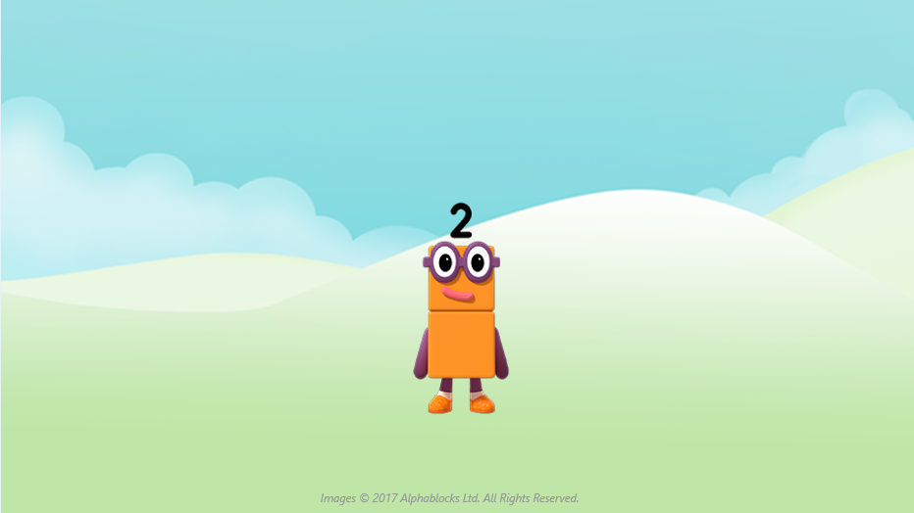

Slide 17
Around the home
Look around your home. What can you see 1, 2, 3, or 4 of?
Four has some things in his home which have four parts, e.g. four corners on each window, four legs on the table. Can you find things in your home which have four parts?
Can you draw a picture for Two or Three? Your picture needs to have two or three of each thing, e.g. two flowers, two people, two cars.
Keep practising putting up the right number of fingers to match things you can see, e.g. if you can see three swings, show three fingers.
Can you make a present for Four? He is not a bad wolf at all! Use four sticks, bricks, pasta or four of something else.

Slide 18
General tips that can make a difference in maths
Provide lots of opportunities to say how many things you can see (up to 5) without counting.
Whenever you talk about a small set of objects, say the number. For example, please pick up those 3 teddies or look at those 2 dogs.
Count up (starting from one) when walking upstairs and count back when walking downstairs.
Count lots of different objects, big and small, and ask ‘How many are there?’ Your child should be able to tell you without going back and re-counting. If they can’t, then tell them: ‘There are 6 altogether’.
Play with fingers, firstly practise counting fingers.
Ask your child to put their fingers down and then say or hold up a number such as 3. Can they do it without counting? Can they do it using different fingers? Can they do it using fingers from two hands?
Play board games with your child which involve moving along numbered tracks, such as ‘Snakes and Ladders’. Check that your child counts along the track correctly, moving one square for each number counted.
Regular use of these simple ideas, whenever the opportunity arises, will improve your child’s maths.

Slide 19
General tips that can make a difference in maths
Notice when there are two amounts and one is more than the other, or they are the same. For example, I have 2 eyes and 2 ears, or I have more chips than peas.
Talk about and describe shapes you can see outside or around your home. For example, count corners, talk about straight/curved edges, flat/curved surfaces. If you have building blocks then talk about and describe the things that are built.
In the bath or at the sink, play with containers, pouring water, counting how many small pots are needed to fill the big container.
Encourage your child to draw a picture of their number work and explain their mark-making to you, for example, how many leaves they find on a walk. This doesn’t necessarily mean writing the numerals (1, 2, 3, 4… etc.).
Sing counting songs and rhymes. You can find some on the internet, but children love it if you join in with them!
Make a deliberate maths mistake from time to time and ask your child to explain why you are wrong. For example, say that 4 is bigger than 5.
Regular use of these simple ideas, whenever the opportunity arises, will improve your child’s maths.

