Slide 1
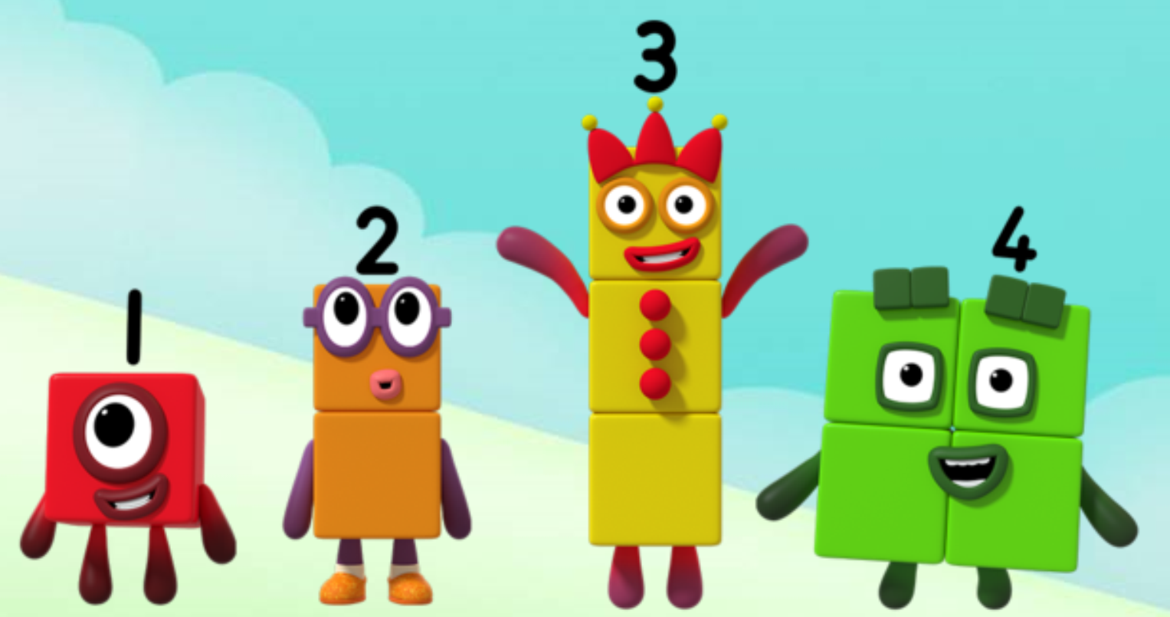
Series 1 Episode 12
The Whole of Me

Slide 2
Maths in the Episode
To watch this episode, please go to BBC iPlayer – Numberblocks. Look for Series 1: The Whole of Me.
Splitting and combining numbers
In this episode children see how numbers can be split into parts and how parts can combine together to make the whole again.
Children can see that numbers can be split in different ways but the whole stays the same, e.g. five can be split into four and one, or two and three.

Slide 3
Talk and discuss together
Watch the episode together.
Ask your child what they noticed and be interested in anything they have to say.
Use the following pictures and activities to explore and talk about the maths involved.

Slide 4
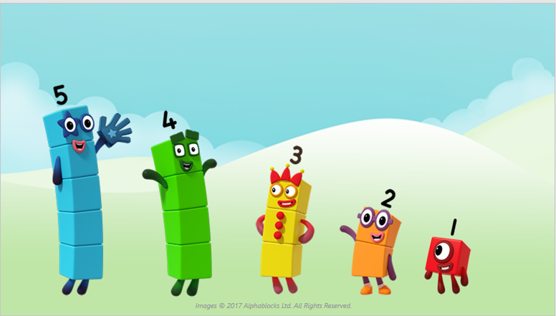
Look at all my friends splitting into parts!
Can you see me hiding inside them?

Slide 5
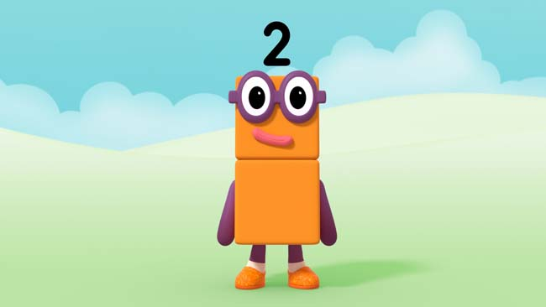
Look how I can split!
Images © 2017 Alphablocks Ltd. All Rights Reserved.

Slide 6
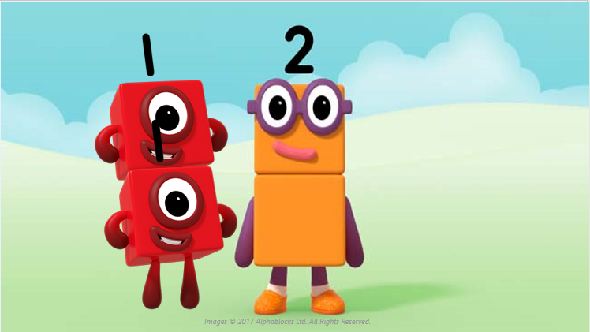
I can split into one and one. The whole of me is two!

Slide 7
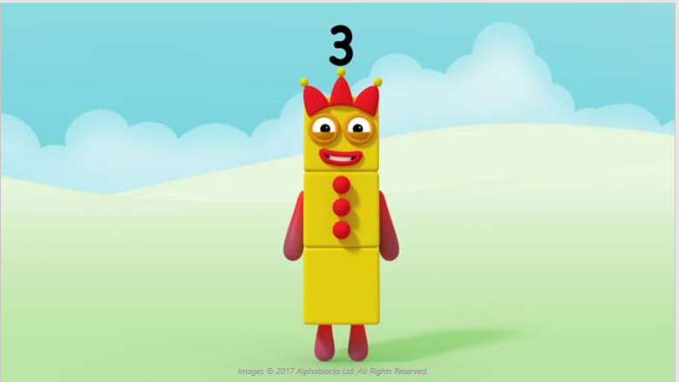
Look how I can split!

Slide 8
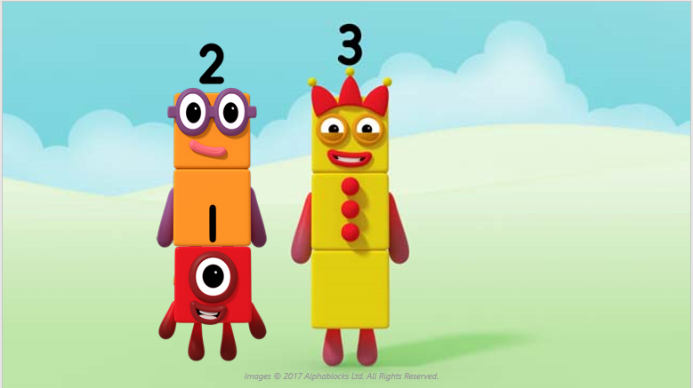
I can split into two and one. The whole of me is three!

Slide 9
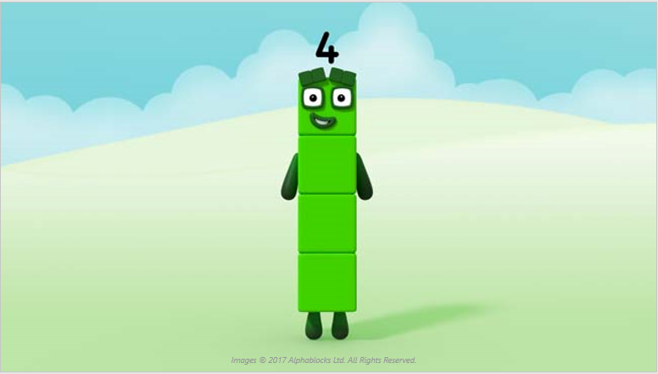
Look how I can split!

Slide 10
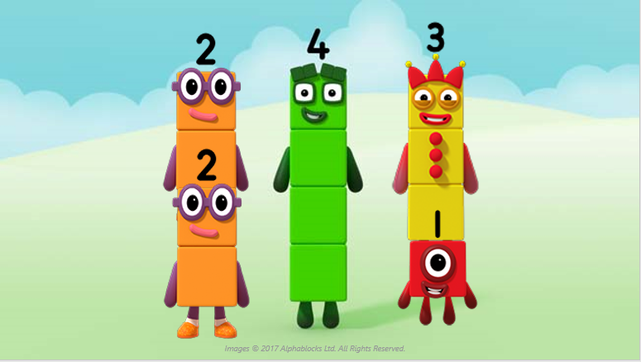
I can split into two and two or three and one!
The whole of me is four!

Slide 11
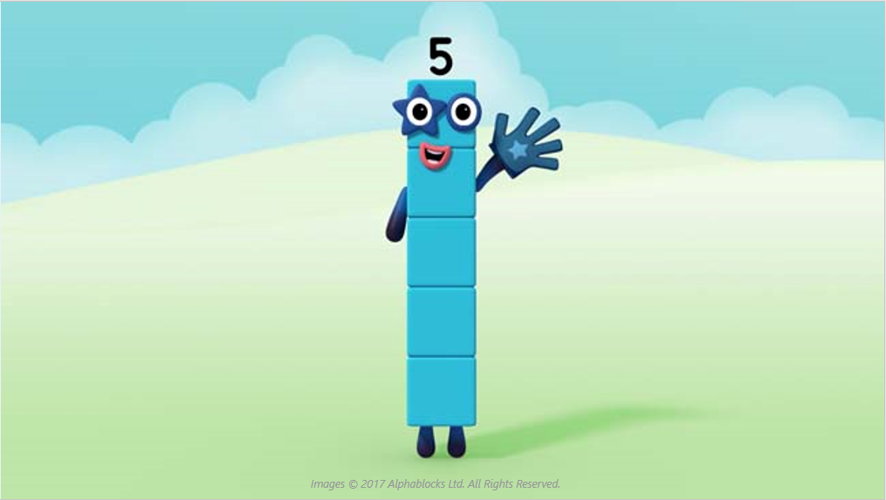
Can you say how I can be split?

Slide 12
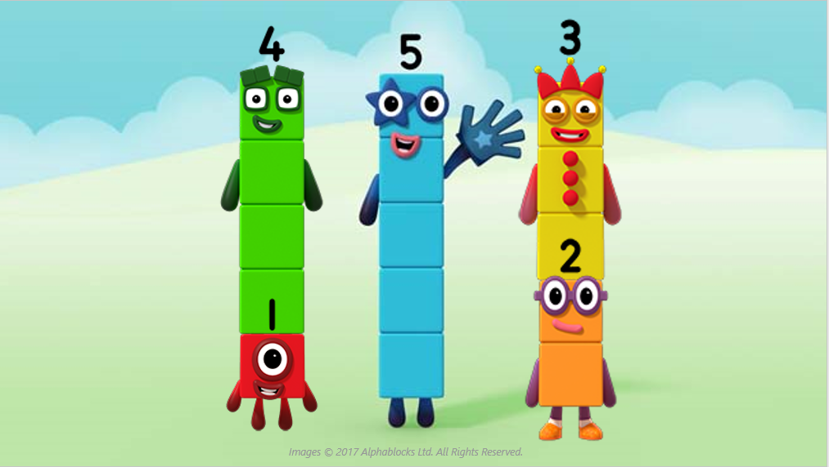
Five can split in different ways!

Slide 13
Around the home
Talk about parts and wholes for different things you see in your home, e.g. a handle is a part of the mug, a tap is a part of the sink.
Make a simple jigsaw by cutting the front of a cereal box into three or four parts. Talk about how the parts look different but still make the whole when we fit them together again.
Using small quantities up to 5, separate them into two groups and talk about the whole and the parts, e.g. three toy cars, one big one and two small ones; four glasses, two have water in and two are empty.
Make a throwing game with five balls of scrunched-up paper. Make a target, e.g. a shopping bag, and see how many balls you can throw into the bag and how many land outside the bag.
Practise showing three, four or five fingers; see if you can find different ways to show a number using two hands, e.g. two fingers on one hand and three fingers on the other hand to show five.
Collect three, four or five toys and hide some of them under a cloth – see if you can say how many are hidden.

Slide 14
General tips that can make a difference in maths
Provide lots of opportunities to say how many things you can see (up to 5) without counting.
Whenever you talk about a small set of objects, say the number. For example, please pick up those 3 teddies or look at those 2 dogs.
Count up (starting from one) when walking upstairs and count back when walking downstairs.
Count lots of different objects, big and small, and ask ‘How many are there?’ Your child should be able to tell you without going back and re-counting. If they can’t, then tell them: ‘There are 6 altogether’.
Play with fingers, firstly practise counting fingers.
Ask your child to put their fingers down and then say or hold up a number such as 3. Can they do it without counting? Can they do it using different fingers? Can they do it using fingers from two hands?
Play board games with your child which involve moving along numbered tracks, such as ‘Snakes and Ladders’. Check that your child counts along the track correctly, moving one square for each number counted.
Regular use of these simple ideas, whenever the opportunity arises, will improve your child’s maths.

Slide 15
General tips that can make a difference in maths
Notice when there are two amounts and one is more than the other, or they are the same. For example, I have 2 eyes and 2 ears, or I have more chips than peas.
Talk about and describe shapes you can see outside or around your home. For example, count corners, talk about straight/curved edges, flat/curved surfaces. If you have building blocks then talk about and describe the things that are built.
In the bath or at the sink, play with containers, pouring water, counting how many small pots are needed to fill the big container.
Encourage your child to draw a picture of their number work and explain their mark-making to you, for example, how many leaves they find on a walk. This doesn’t necessarily mean writing the numerals (1, 2, 3, 4… etc.).
Sing counting songs and rhymes. You can find some on the internet, but children love it if you join in with them!
Make a deliberate maths mistake from time to time and ask your child to explain why you are wrong. For example, say that 4 is bigger than 5.
Regular use of these simple ideas, whenever the opportunity arises, will improve your child’s maths.

